Slide 1

Customer Segmentation on Walmart Reviews
Team Members
Pemmasani Prudhvi Nadh.
Venkata Naga Sai Ginjupalli

Slide 2

Introduction
Customer reviews serve as a priceless treasure trove of knowledge in the huge field of retail, and when it comes to the retail giant Walmart, this trove becomes extremely deep and diverse. Walmart, as a worldwide retail juggernaut, attracts a diverse range of customers , via their reviews, offer a detailed image of their interactions with products, services, and the entire shopping experience.
Motivation:
Understanding Customer Sentiment: Analyzing customer reviews assists in gauging Walmart customers' thoughts and opinions about the products and services offered. This information is useful in understanding overall consumer happiness.
Product Improvement: Specific suggestions concerning products are frequently included in customer feedback. Review analysis can provide useful information about what customers like and hate about specific products, assisting Walmart in identifying areas for development.
Analyzing customer reviews not only provides insights into Walmart's performance, but also helps to understand how it compares to competitors. This knowledge can be critical for making strategic decisions.
Identifying Trends: Walmart can uncover growing trends in customer preferences by studying reviews at scale. This can be important for making educated inventory, marketing, and product development decisions.

Slide 3

Motivation
Data-Driven Decision-Making: The analysis of customer reviews provides a data-driven approach to decision-making. Instead of relying solely on surveys or focus groups, Walmart can leverage the vast amount of customer-generated data available in reviews.
Insights from consumer reviews can be used to improve operations by include feedback on services, delivery, and the overall purchasing experience. This data can be used to influence operational improvements to improve the overall client trip.
Predictive Analytics: Historical evaluations can be utilized to construct predictive models that predict future customer patterns and preferences, allowing Walmart to stay ahead of the competition.

Slide 4

Significance:
Understanding Customer Sentiment: NLP enables us to accurately assess customer sentiment. Businesses like Walmart can find areas of strength and weakness in their products and services by determining if evaluations indicate favorable, negative, or neutral opinions.
Identifying Emerging Trends: Using NLP to analyze customer evaluations allows for the detection of emerging trends and preferences. This data is critical for staying ahead of the market, supplying popular items, and reacting to changing consumer requests.
Product Improvement Insights: NLP can reveal particular parts of items that buyers like or dislike. This data is crucial for product development teams, since it allows them to prioritize improvements based on actual user feedback.
Enhancing client Experience: Understanding the intricacies of client feedback through NLP enables the overall customer experience to be improved. These insights can drive good change, whether it's optimizing operations, resolving common problems, or enhancing service quality.

Slide 5

Problem Statement
As the world's largest retailer, Walmart has the difficulty of quickly deriving useful data from a tremendous amount of customer feedback. Understanding client attitudes, identifying particular areas for development, and using feedback for strategic decision-making are all hampered by the unstructured nature of these assessments. The issue is divided into several important components.
Sentiment Analysis: To perform sentiment analysis on customer evaluations, Walmart must construct effective natural language processing (NLP) models. To evaluate overall consumer satisfaction, it is necessary to appropriately categorize reviews as positive, negative, or neutral.
Aspect-Based Sentiment Analysis: It is critical to understand sentiment at the granular level. Walmart seeks to uncover attitudes linked with certain areas of product quality, customer service, pricing, and overall shopping experience expressed in reviews.
Topic Modeling: Understanding the subjects that are most important to customers requires extracting key topics and themes from customer evaluations. This entails categorizing reviews into categories using topic modeling approaches such as Latent Dirichlet Allocation (LDA) or Non-negative Matrix Factorization (NMF).
Predictive Analytics:
Walmart is attempting to develop predictive models that anticipate customer trends and preferences. This entails reviewing historical evaluations to detect patterns and forecast future client actions, allowing the organization to stay ahead of the competition in achieving customer expectations.

Slide 6
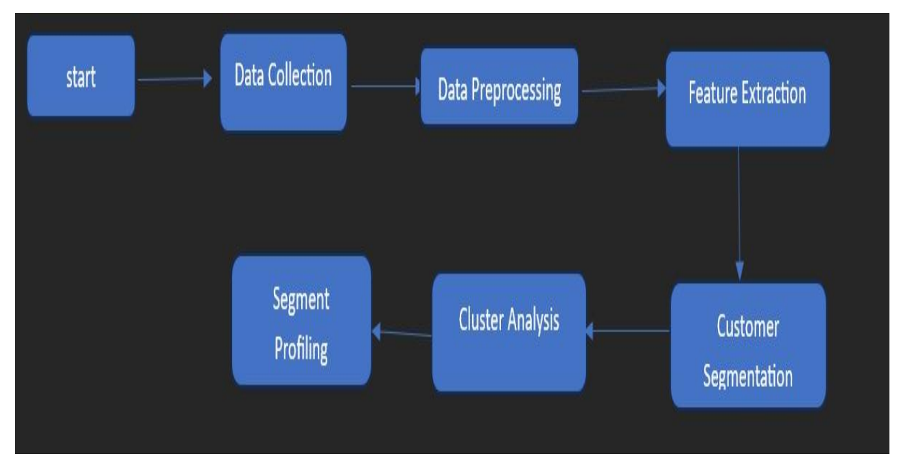
Model/Methodology

Slide 7
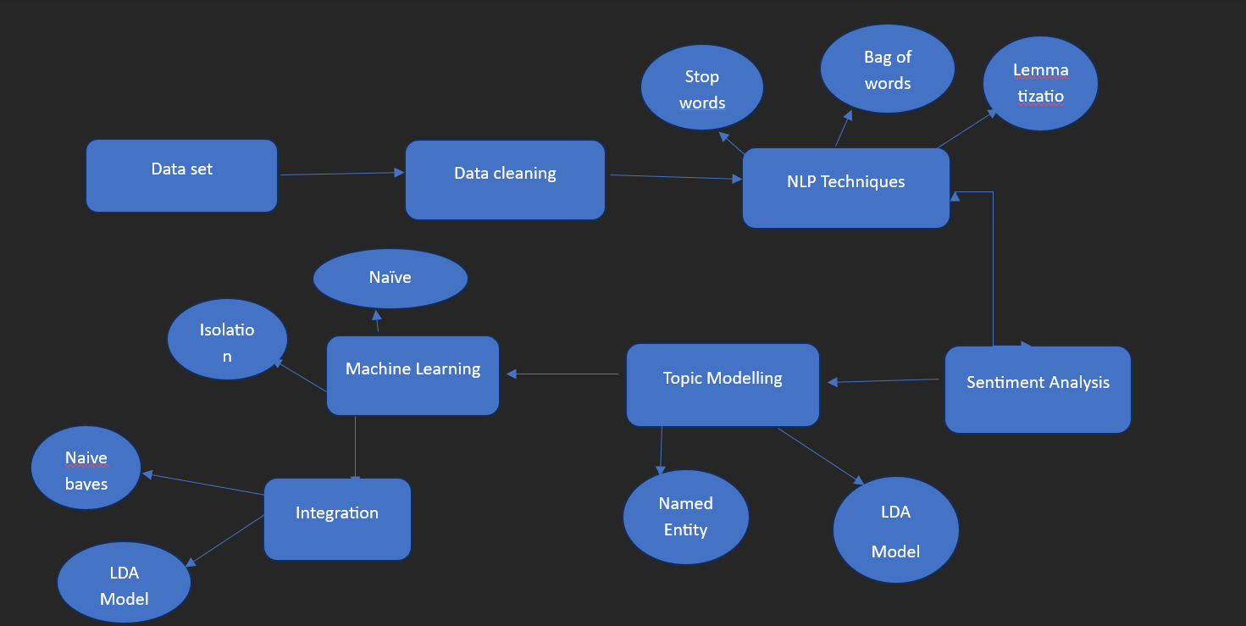
Architecture Diagram

Slide 8

Dataset
Description/Representation of Dataset:
Name:The name of the product or item being reviewed is most likely represented by this characteristic. It acts as a one-of-a-kind identifier for each product in the dataset.
Location:This characteristic most likely shows the reviewer's location. Understanding the global distribution of reviews can reveal regional preferences or differences in customer experiences.
Reviews:The "Reviews" function contains customer submitted feedback or remarks. This is an important element of the dataset since it contains qualitative data that may be examined using Natural Language Processing (NLP) techniques to extract sentiments, subjects, and other useful insights.
Date: The "Date" feature represents the time and date the review was published. Analyzing reviews over time might indicate trends, seasonality, or changes in customer opinions, all of which can help firms adjust to changing consumer preferences.
Ratings:This feature includes numerical ratings from consumers that show their overall satisfaction with the product or service. Ratings give a quantitative metric that can be studied to determine the average level of satisfaction, identify highly rated items, or suggest areas for development.
Image Sources: Image links are most likely URLs or links linking to photos related to the product or the review. Images could contain product images, receipts, or other pertinent visuals. While not directly analyzable using typical NLP, some connections could be.

Slide 9

Features:
Stemming or lemmatization: Words are transformed into their base or root form. This stage reduces the data's dimensionality and assures uniformity in word representation.Stopword Elimination:
Common terms (stopwords) that do not contribute significant meaning to the text are eliminated. This is critical for enhancing downstream analysis efficiency.
LDA and NMF (Topic Modeling):
Latent Dirichlet Allocation (LDA) or Non-negative Matrix Factorization (NMF) algorithms can be used to find latent topics within reviews, assisting in the discovery of underlying themes.
NER (Named Entity Recognition):
Identifying and categorizing items inside the text (such as product names, locations, or dates). NER has the potential to improve information extraction and categorization.
Text Vectorization Techniques (Word Embeddings, Bag of Words):
Text is converted into numerical vectors for machine learning models. This is required for training models such as Naive Bayes, Logistic Regression, and neural networks.
Metrics for Model Evaluation:
Metrics like accuracy, precision, recall, and F1-score are essential for evaluating the effectiveness of machine learning models used for sentiment analysis or other classification tasks.

Slide 10

Exploratory data analysis
Data Preprocessing.
Load the Data
Data cleaning
Handle Missing data.
Text cleaning.
Feature Selection.
Integration

Slide 11
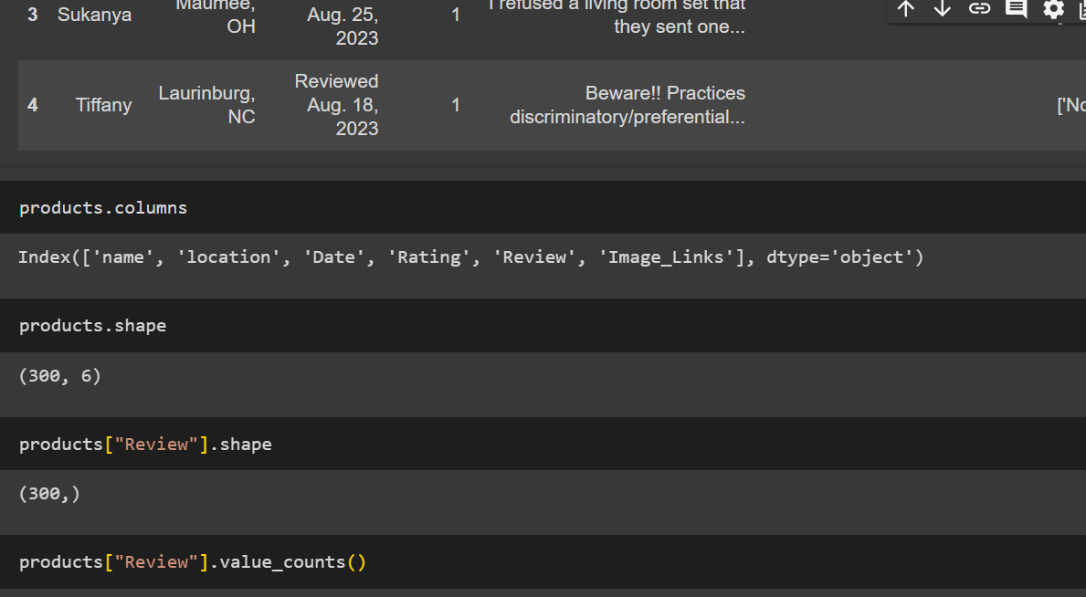

Slide 12
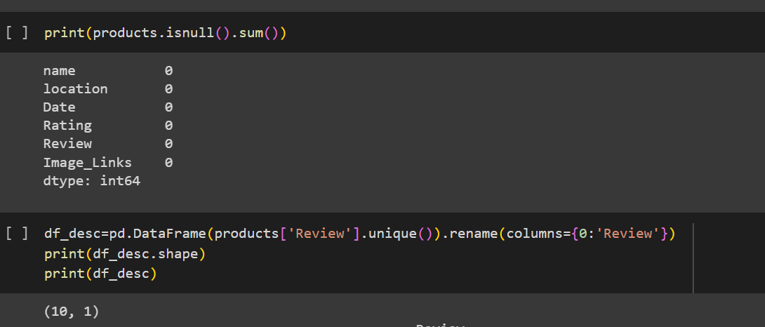

Slide 13
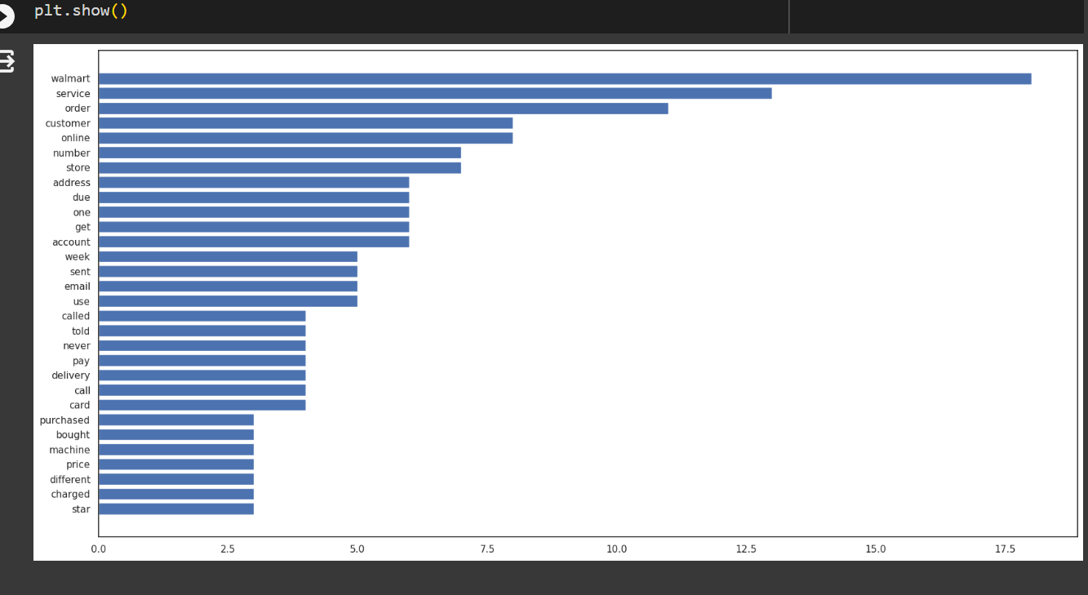
Data visualization

Slide 14
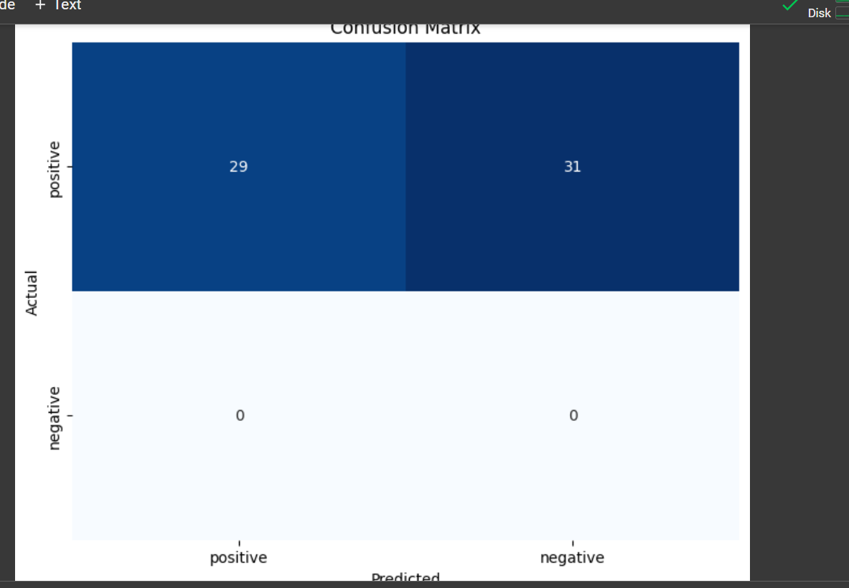

Slide 15
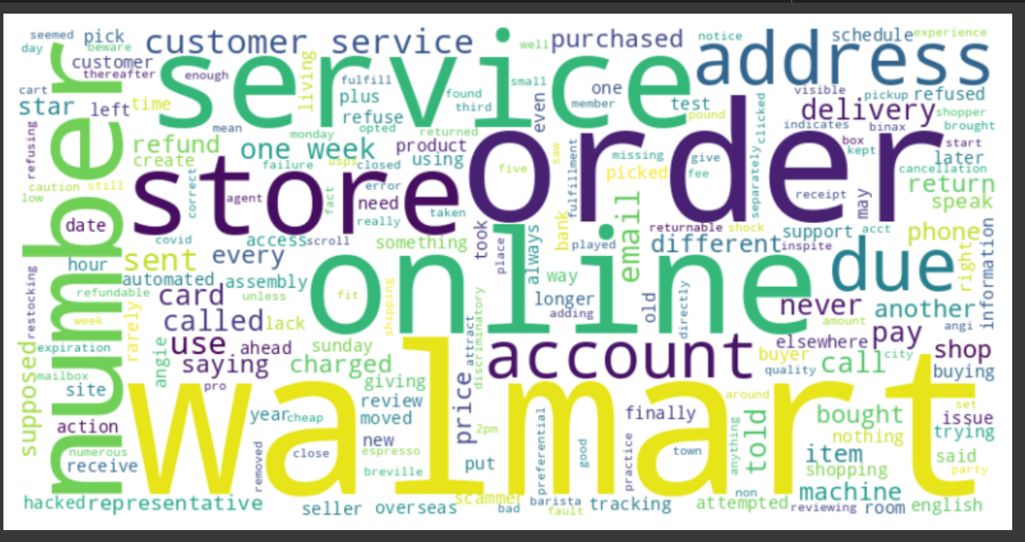

Slide 16

Implementation
Algorithms:
Data cleaning
Data preprocessing
Data visualization
NLP Techniques
Stopwords
Bag of words
Lemmatization
Topic Modeling
LDM Modelling.
Machine Learning models
Isolation forest algorithm
Naïve Bayes
Integration
Naïve Bayes
LDM Model

Slide 17
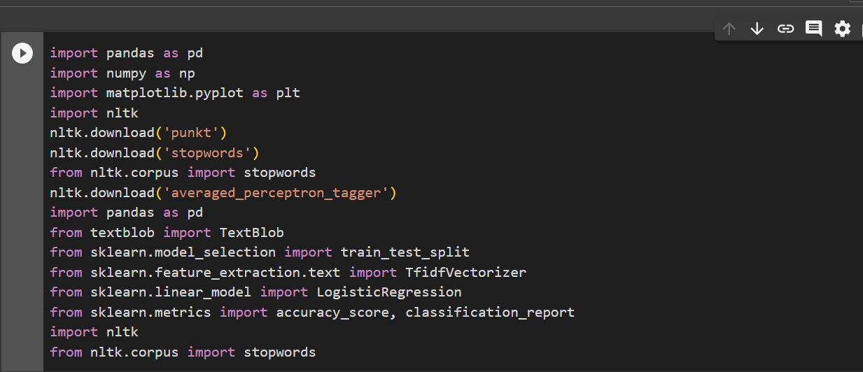
Implementation of Libraries

Slide 18

Explaination
For assessing Walmart reviews, the merging of Naive Bayes and Latent Dirichlet Allocation (LDA) models is a comprehensive strategy that blends probabilistic classification and topic modeling techniques. Naive Bayes is used as a classifier in this integration to identify the sentiment polarity of the reviews, categorizing them as positive, negative, or neutral. At the same time, LDA is used to reveal latent topics within the reviews, providing insights into the underlying themes and subjects discussed by customers. Businesses can acquire a dual-layered view of client feedback by combining these models—Naive Bayes gives sentiment analysis for overall satisfaction evaluation, while LDA reveals the nuanced subjects affecting customer perceptions. This connection allows for a more comprehensive analysis, providing both sentiment labels and topic distributions, thus increasing the depth and breadth of the investigation.

Slide 19
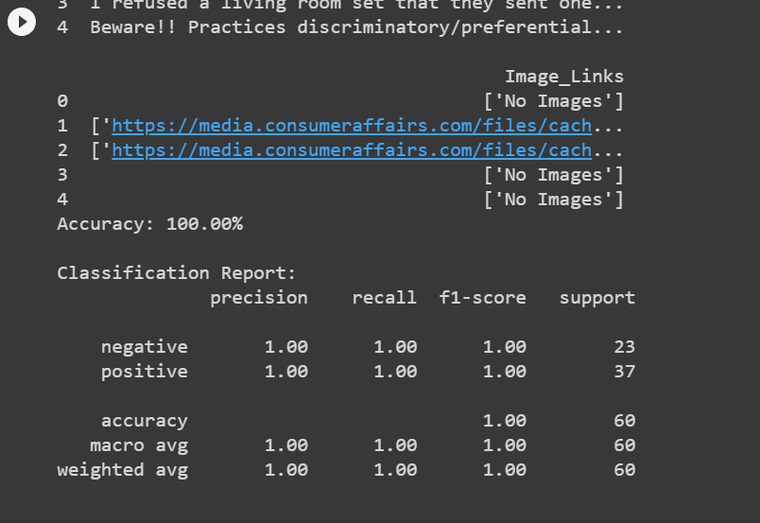
Results

Slide 20
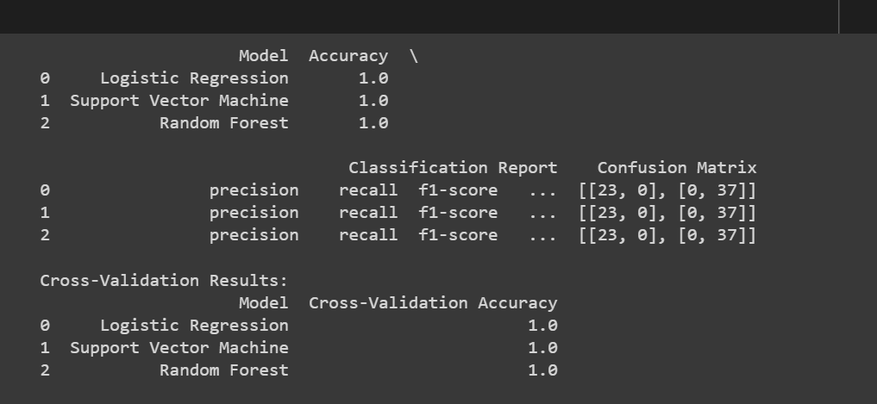

Slide 21
Explanation
Using a combination of natural language processing (NLP) techniques and machine learning, we performed sentiment analysis on a Walmart reviews dataset. The script preprocesses the text after importing it into a Pandas DataFrame by deleting frequent English stopwords. The TextBlob library is used to assign sentiment labels ('positive,' 'negative,' or 'neutral') to each review. The data is then divided into training and testing sets, and the text data is converted into numerical features using TF-IDF vectorization. A Logistic Regression model is trained on the training set's TF-IDF vectors and tested on the testing set, producing an accuracy score and a complete classification report with precision, recall, and F1-score metrics for each sentiment class. This comprehensive strategy exemplifies the convergence of NLP and machine learning.

Slide 22

Project Management
Implementation statusreport
▪ Work completed
Ginjupalli Venkata Naga Sai ( 50 %)
Data Extraction.
Data Cleaning
Text cleaning
Exploratory Data analysis
Pemmasani Prudhvi Nadh (50%)
NLP Techniques .
Machine Learning Models
Integration of Models.

Slide 23

Reference/Biblography
https://www.researchgate.net/figure/Walmart-volume-and-sentiment-for-other-service-quality-metrics_fig2_318189993
https://www.kaggle.com/discussions/general/440966
https://www.kaggle.com/datasets/harshalhonde/walmart-reviews-dataset

